Slide 1

The Insurance Company
Predictive Data Analytic Model

Slide 2
Background
The Insurance Company
Provider of automobile, life, property, and other policies
Current Marketing Strategy
Emails promotions to each and every customer
This makes active customers more likely to cancel their insurance policies and less likely to purchase additional insurance
It can be improved by predicting insurance ownership and removing active customers from mailing lists
Undertaking pilot analysis focused on caravan insurance

Slide 3

Data
Supplied by Sentient Machine Research (SMR) group based out of Amsterdam, the Netherlands
Three files;
Training data
Validation data
Validation targets
Attributes
½ Economic & demographic info
½ Product ownership information

Slide 4
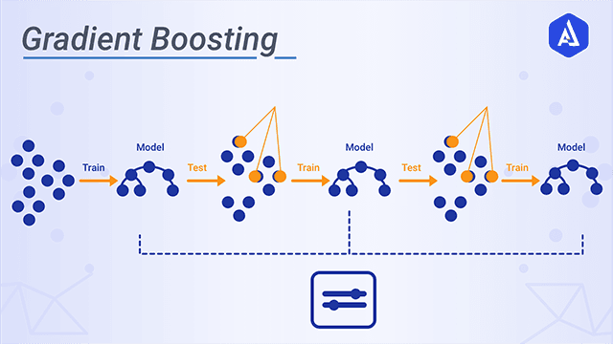
Model Selection
Binary classification model
Decision tree structure
yes/no output
Proportional predictions
Ensemble learning
Boosting
Recommendation
Gradient Boosting Machine

Slide 5
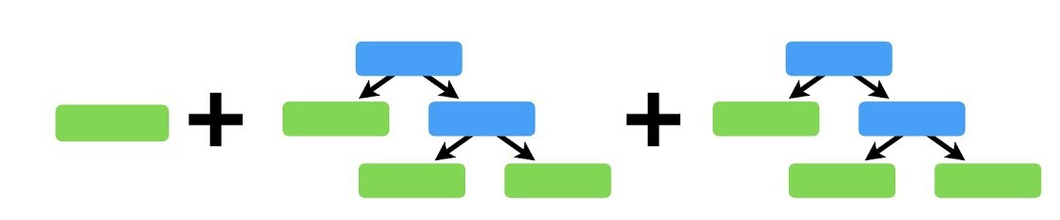
Model Development
fitControl <- trainControl(method="cv", number=5, returnResamp = "all")
tuneControl <- data.frame(.n.trees=1000, .shrinkage=0.01, .interaction.depth=30, .n.minobsinnode=1)
set.seed(10)
model2 <- train(CARAVAN~., data=coil, method="gbm", distribution="bernoulli", trControl=fitControl, verbose=F, tuneGrid=tuneControl)
x 1000

Slide 6
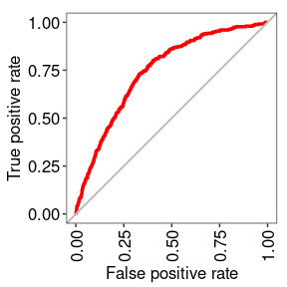
Model Evaluation
Variable Importance
Area Under Curve (0.74)
Variable | Relative Influence
Customer Subtype | 6.676186
Car Policy Contribution | 6.324712
Fire Policy Contribution | 5.967528
Third Party Policy Contribution | 4.447999
Religion – Protestant | 2.639266
Religion – No Religion | 2.637284

Slide 7
Scoring Engine
Applies the model to new data and uses the predictions to guide their strategy
Expected results can be estimated using the confusion matrix
Reference Prediction 0 1 0 5469 156 1 5 192
The Insurance Company can expect to successfully eliminate 55% (192 / 192 + 156)of current caravan policy holders, at the cost of missing less than one in a thousand (5 / 5 + 5469) potential prospects.

